Slide 1


Team 4: Automatic Solar
Lighting System
Bi-Weekly Update 5
Atahan Bakanyildiz, Romi Gilat,
Cedar Maxwell, Nick Miller
Sponsor: Wohnyeok Jang TA: Fahrettin Ay
Notes:
Michelle

Slide 2
What is the Automatic Solar Lighting System?
Problem:
Increasing grid demand and reliability issues make power outages more frequent.
Integrating solar energy into homes ensures a dependable and independent power source.
Solar power provides backup energy during outages, reduces electricity costs, and supports sustainability.
Solution:
Solar panels provide up to 3 days of reliable power during emergencies.
Motion-activated lighting for the foyer and patio ensures security and efficiency.
Remote control via an app allows convenient access and management of the system.
Enhances energy independence, cost savings, and sustainability for homeowners.
Notes:
Kyle

Slide 3
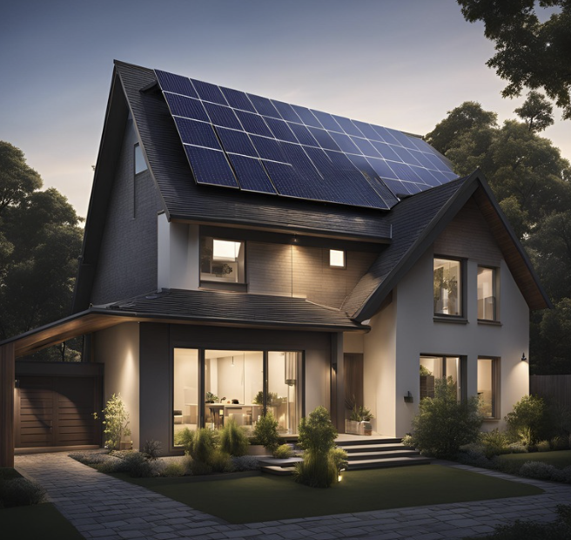
System Visual

Slide 4
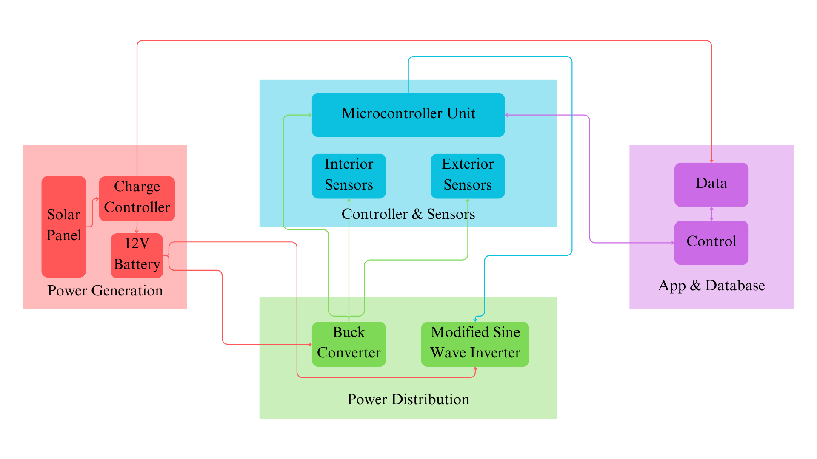
Project/Subsystem Overview
Nick: Power Distribution Atahan: Power Generation
Romi: Controller & Sensors Cedar: App & Database
Notes:
Eric

Slide 5
Project Timeline
Subsystems designed and completed testing (Complete) | Integration of MCU and Power generation (Completed) | Integration of MCU and Android App (In progres) | Integration of MCU and power distribution (In progres) | System Test (In progres) | Validation (In progres) | Demo and Report (to complete by 4/28)
Notes:
Eric

Slide 6
Controller & Sensors
Romi Gilat
Accomplishments since last update 45 hrs of effort | Ongoing progress/problems and plans until the next presentation
Finalized sensors Finalized MCU & Sensor integration Completed integration with power monitor | Continue integration with App & power generation Refine MCU code with system to ensure no misfires Validation and testing for system Build house model

Slide 7
Sensors
 | Testing distance: | Hit rate:
Exterior Sensor | 7 ft | 100%
Interior Sensor | 25 ft | 100%
Sensors were programmed to trigger for 2 seconds with a 1 second cool down
This is for testing only, actual trigger cooldown time will be 9 minutes 30 seconds
Exterior sensor’s ambient triggered with orange and red screen light, mimicking sunset and sunrise
Notes:
Plan to add affects to slides to show case photos from left to right

Slide 8
Sensors

Slide 9
Sensor MCU communication
Second video, (not automatic and make it replay)

Slide 10
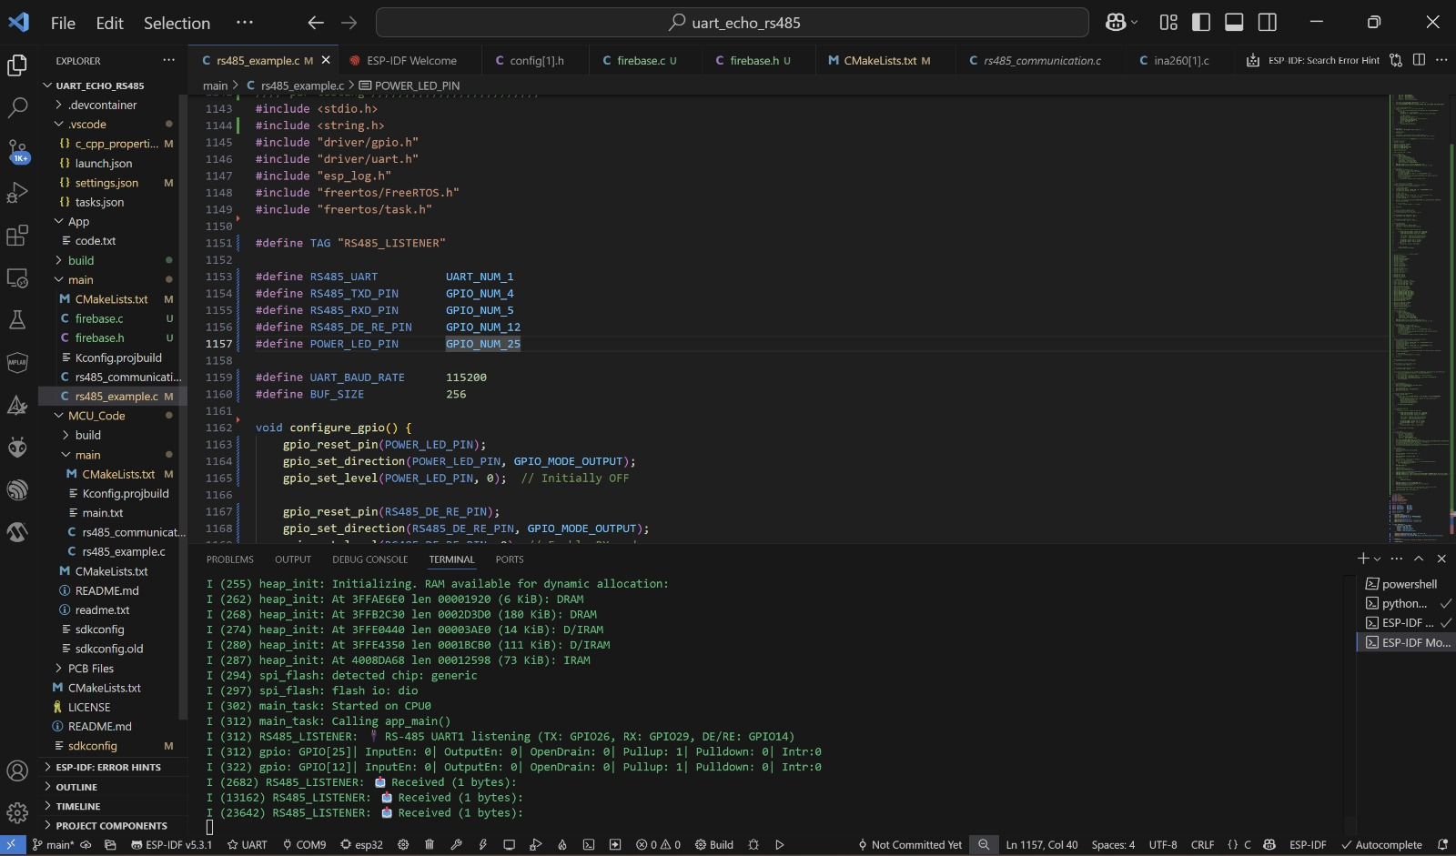

Sensor & MCU

Slide 11
Power Generation
Atahan Bakanyildiz
Accomplishments since last update 25 hrs of effort | Ongoing progress/problems and plans until the next presentation
Power Monitor integrated with MCU | MCU readings from power monitor need to transfer to database Power Monitor data on MCU needs to be integrated with app Power monitor needs to be used with battery and distribution subsystem

Slide 12
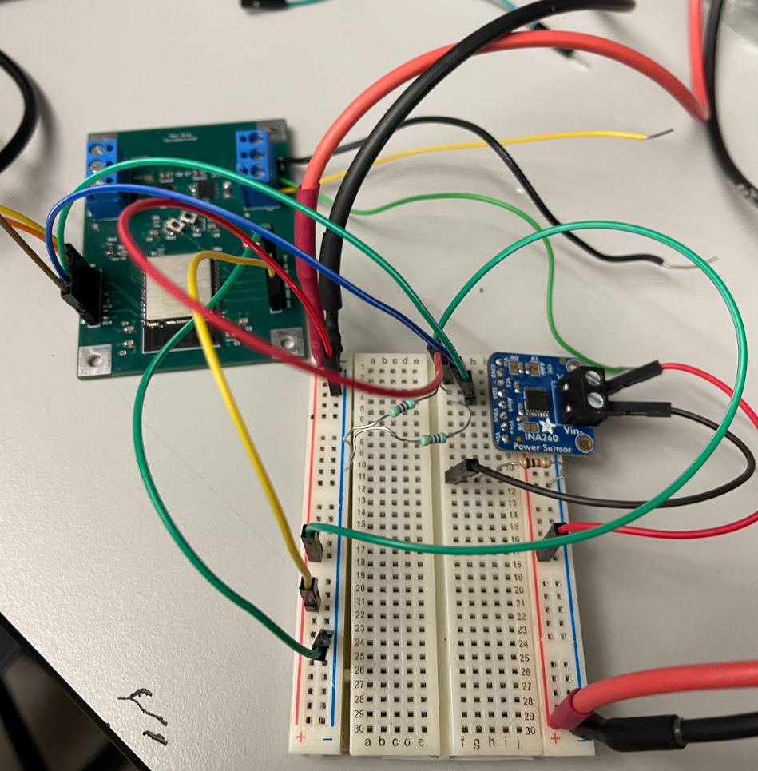
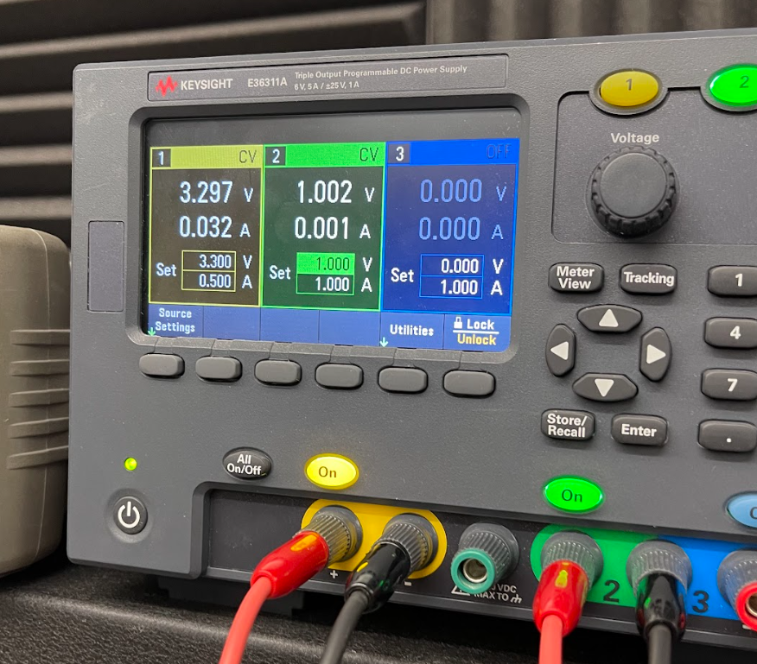
Power Generation
Power Monitor -> MCU

Slide 13
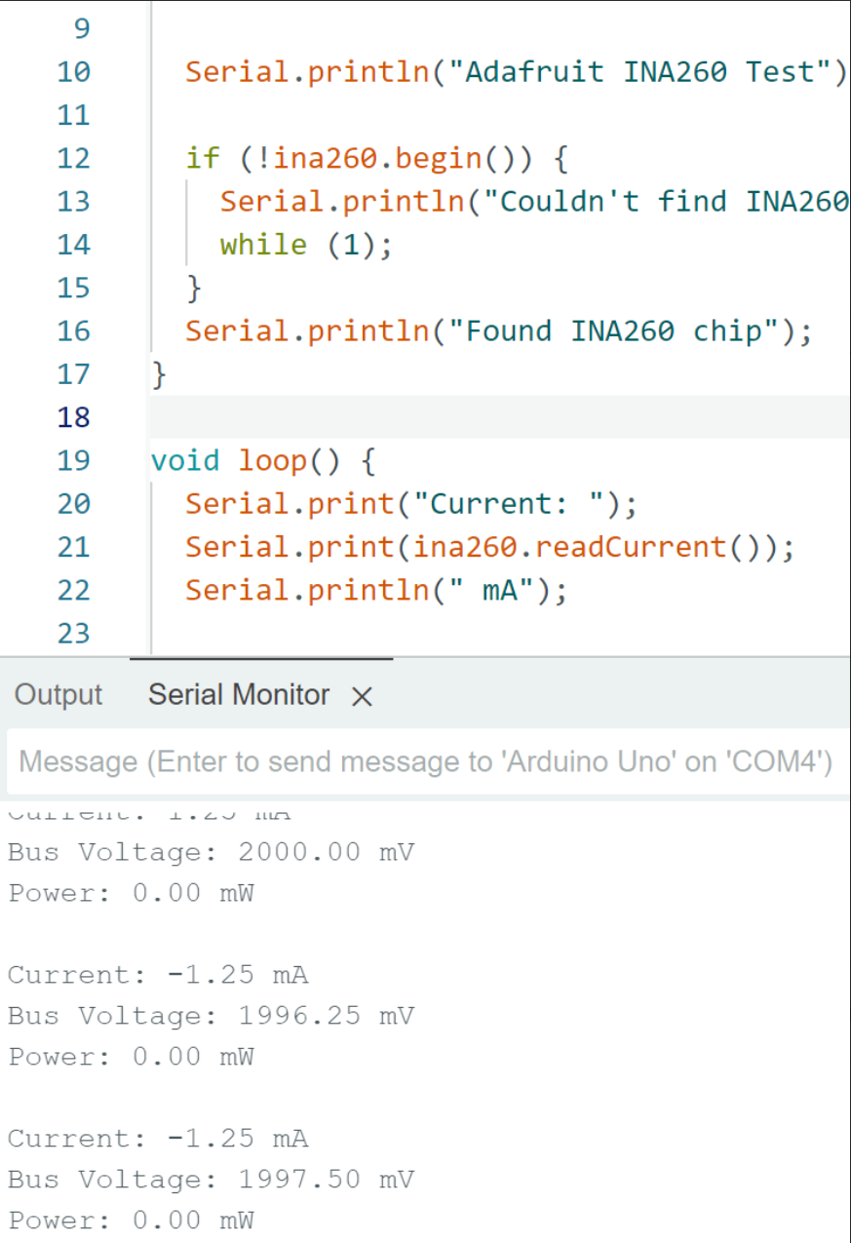
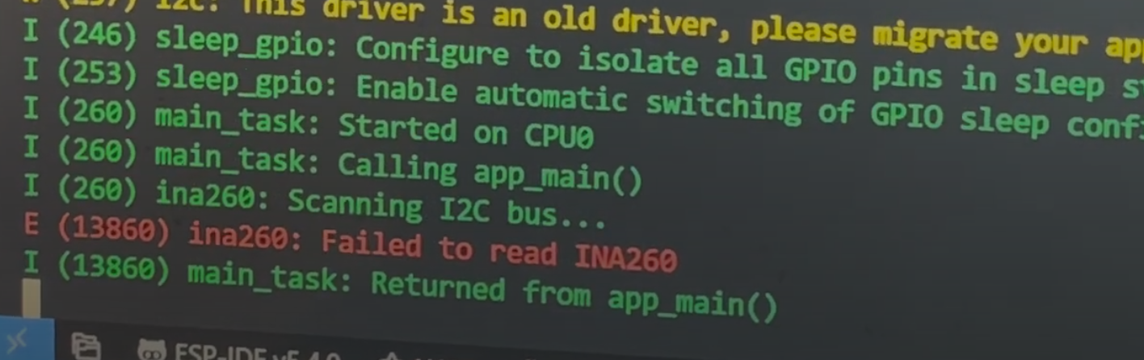
Expected output tested with Arduino:
no load currently
2 V
Test code on ESP32 still not working
Possible errors:
Software/coding problem
Pull up resistors
Microcontroller issues

Slide 14
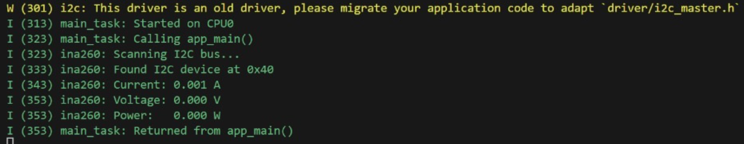
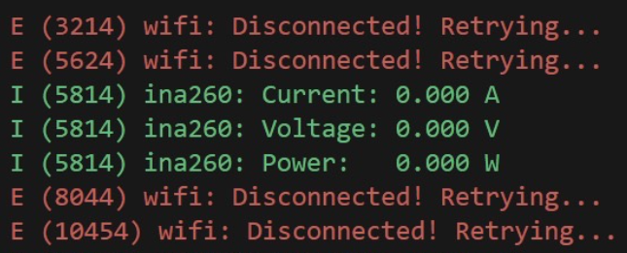
Connected to MCU PCB
Working:
Address and registers of I2C device being read
Issues:
All readings are 0
Only reading once
WIFI code and Monitor code interference

Slide 15
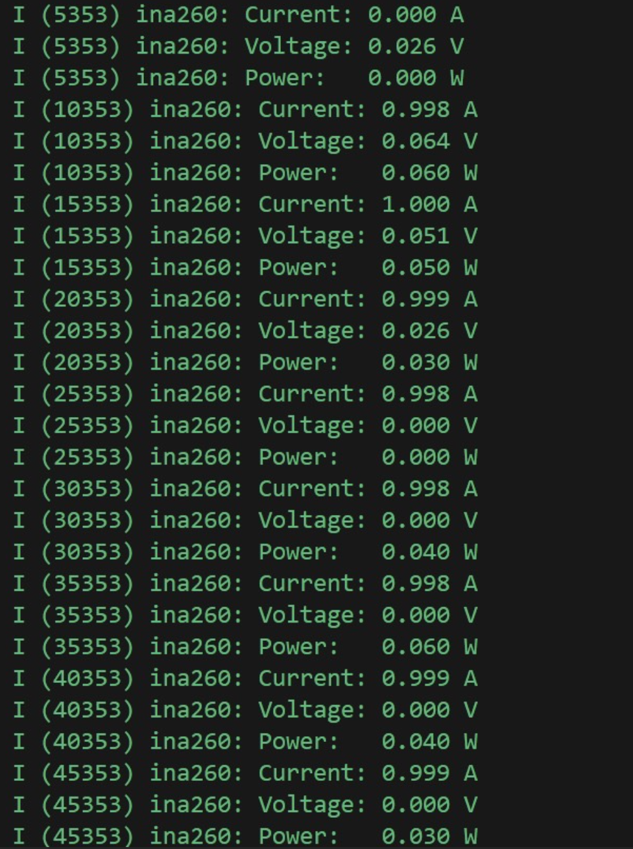
Addressing issues:
Code altered to read every second from device
Tested will different pull up resistors
Iterated code for no interference between other sections
There are readings
nonsense readings
V and A are not switched
Registers are correct
2V 0A !
0V 1A X

Slide 16
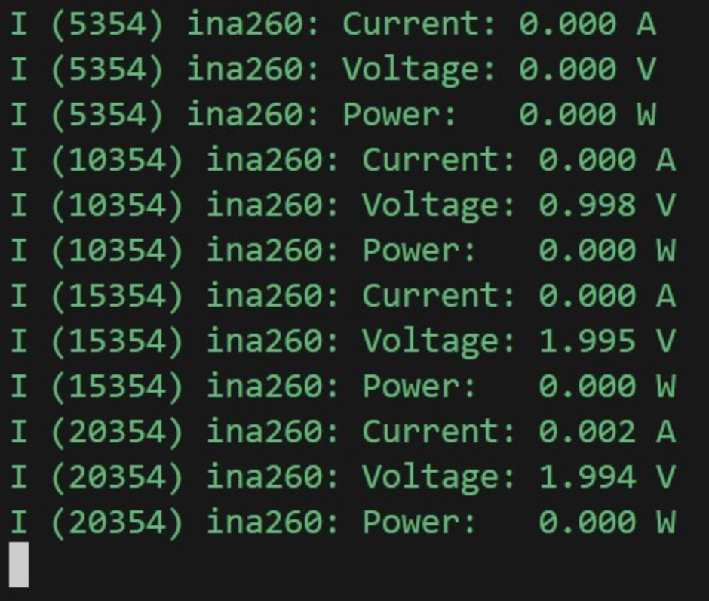
Common Ground:
INA260 chip needs a common ground that powers the trip as well as the load for correct measurements
Tested each second with 0V, 1V, and 2V

Slide 17
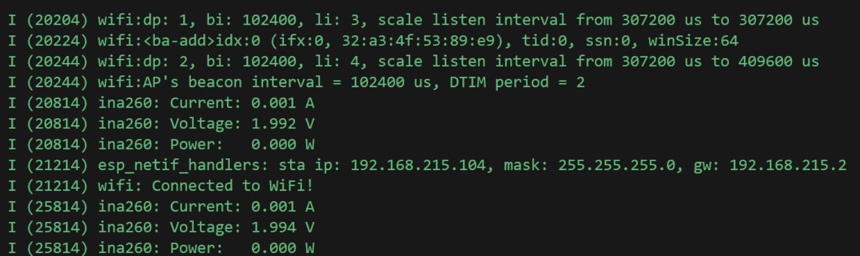
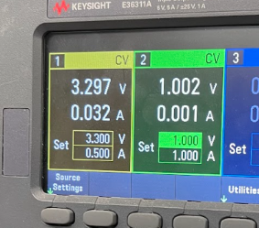
MCU subsystem iterated code for WiFi and Monitor
Accurate readings with margin of error small enough to use in our conditions
To be done:
Using battery instead of power source (Power Distribution)
Data sent to Database and processed by App

Slide 18
App & Database
Cedar Maxwell
Accomplishments since last update 20 hrs of effort | Ongoing progress/problems and plans until the next presentation
ESP32 successfully pushes switch states to Cloud Firestore, which are in turn reflected on the App, in real time. ESP32 successfully gets and parses Cloud Firestore switch states, crucial for the ESP32 to react to switch changes from the App. ESP32 can successfully push graph data to Realtime Database. | Integration still incomplete – ESP32 cannot yet turn off/on light bulb in response to Firebase. App graphs aren’t parsing data from ESP32 correctly, so graphs which worked before, are now broken.

Slide 19
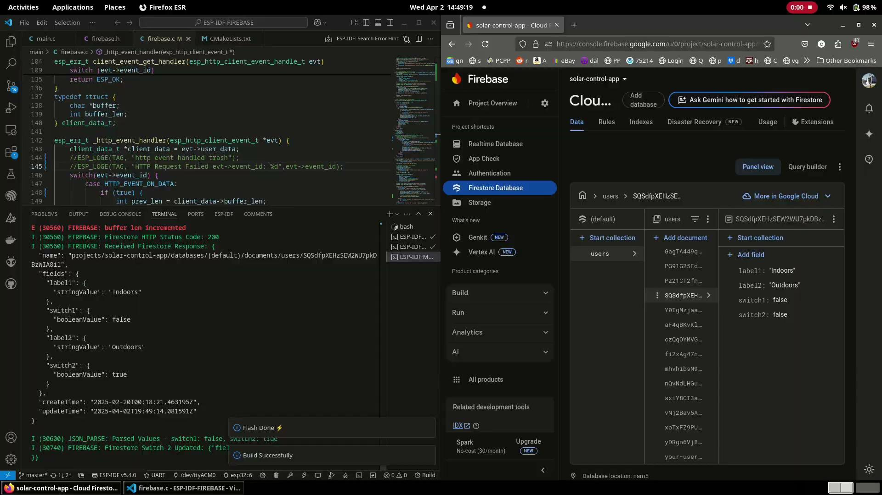
ESP32 pushing switch states to Cloud Firestore

Slide 20
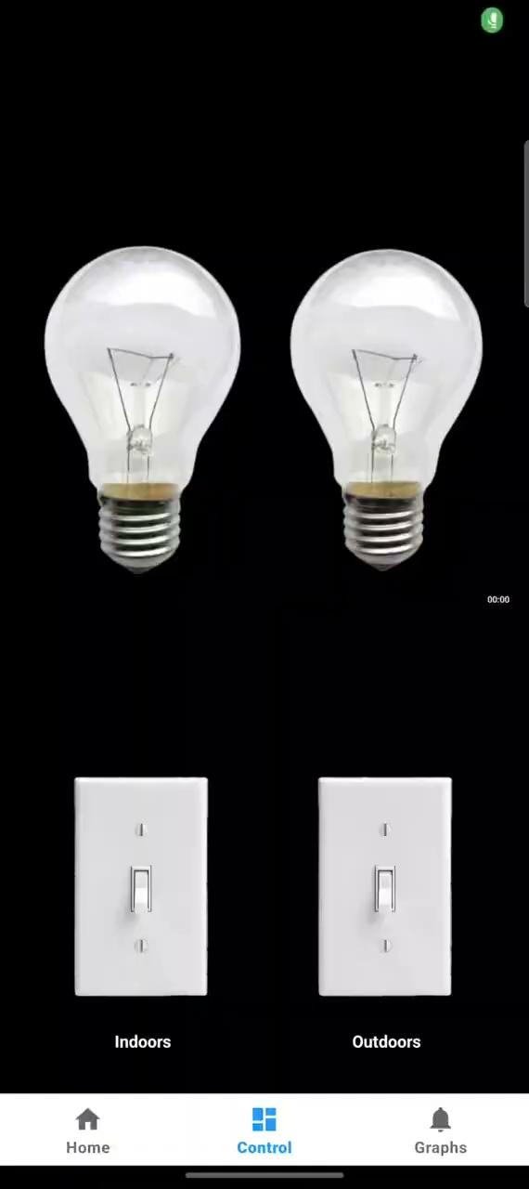
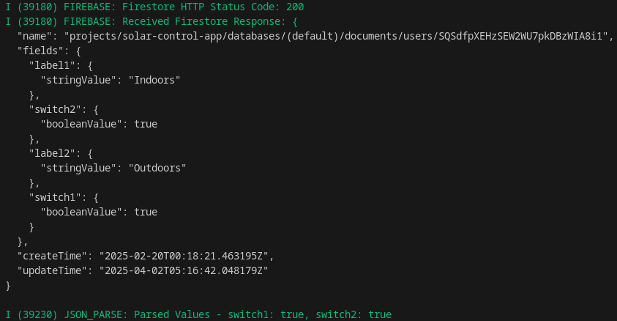
ESP32 retrieving switch states from Cloud Firestore

Slide 21
Power Distribution
Nick Miller
Accomplishments since last update 38 hrs of effort | Ongoing progress/problems and plans until the next presentation
Designed and programmed SPI-controlled Relay Driver to be used in integration with MCU & Sensors. Corrected issues with Buck Converter, tested against E-load to verify functionality. | Parts delay with components for corrected Buck Converter. Edit code for SPI-controlled Relay Driver to ensure all test cases met. Total integration will be completed with constructing the Buck Converter.

Slide 22
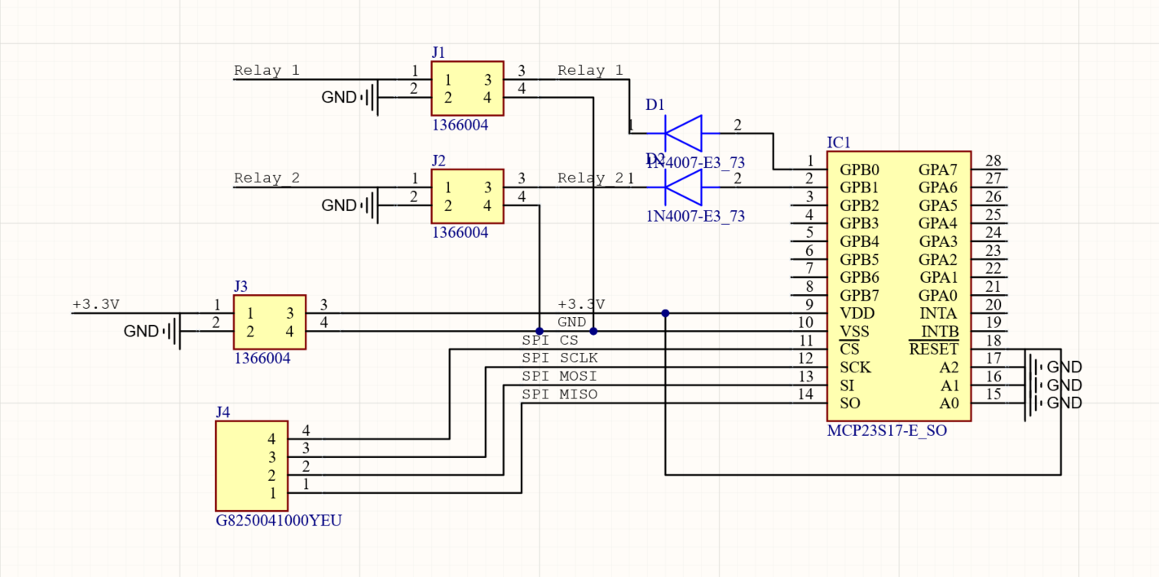
SPI-Controlled Relay Driver

Slide 23
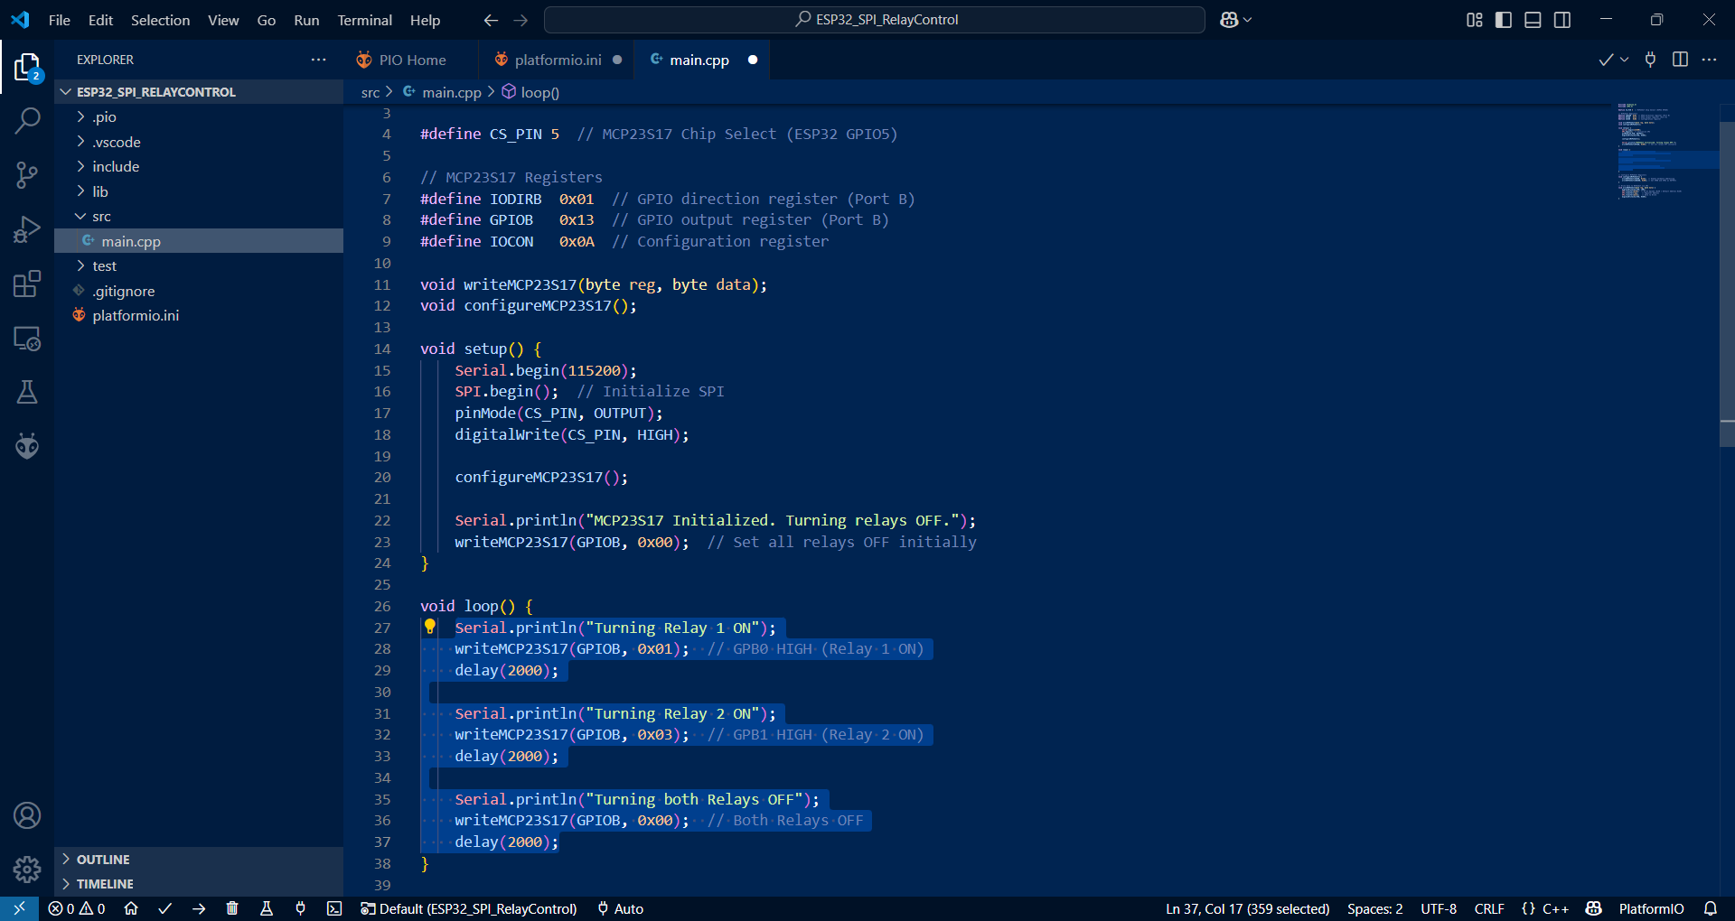
SPI-Controlled Relay Driver

Slide 24
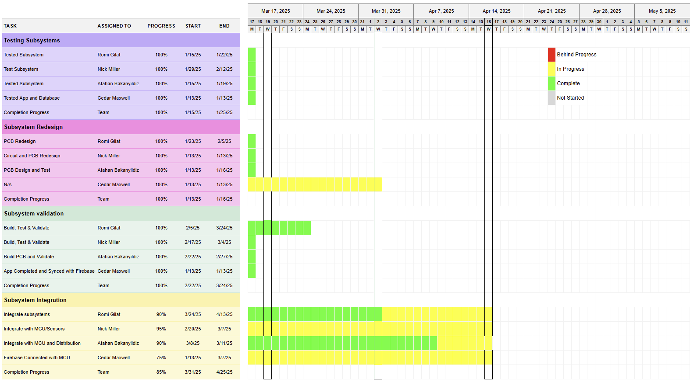
Execution & Validation Plan
Notes:
Michelle

Slide 25
Validation Plan
Standby Wake-Up Miss Rate | The maximum number of miss trigger incidents within the sensor's field of view will be 15% or less. | SUCCESS | Romi Gilat
False Positive Rate | Within the sensor system, the false positive rate will be less than 15% in case of small animals or critters walking within the range. | SUCCESS | Romi Gilat
Battery Operating Time | The operating time of the 12V Lead-Acid battery shall be between 10 and 20 hours. | UNTESTED | Nick Miller
Solar Charging Time | The solar charging time shall be between 4 and 6 hours. | SUCCESS | Atahan
System Area | The system area shall include the rooftop, foyer and exterior of a household. | SUCCESS | Atahan
Installation | The solar panel installation will be done up to National Electrical Code (NEC), International Building Code (IBC), and International Fire Code (IFC), along with the mounting of the system 45 degrees tilted offset from the ground level for optimal sunlight units. | UNTESTED | All
Mounting | The automatic solar lighting system includes solar panels, an indoor sensor with integrated lights, and an outdoor sensor with lights. The lightweight design eliminates the need for structural support, and the solar panels are roof-mounted for optimal sunlight exposure | UNTESTED | All
Inputs | The Automatic Solar Lighting System processes multiple inputs across subsystems. The Power Generation subsystem captures solar energy via photovoltaic panels, while the Buck Converter/Inverter adjusts DC voltage for the MCU and lighting. The app monitors light status and subsystem performance in real time. | Partial Success | Atahan, Nick, Romi
Notes:
Michelle

Slide 26
Validation Plan continued
Power Consumption | The system shall consume approximately 18 Watts, 9 Watts per light bulbs. | UNTESTED | Nick Miller
Input Voltage Level | The input voltage level shall be +10 VDC to +14 VDC. | SUCCESS | Nick Miller
External Commands | The Automatic Solar Lighting System shall document all external commands in the appropriate ICD. | UNTESTED | Cedar Maxwell
Data Output | The Automatic Solar Lighting System will output the status of the porch and foyer lights by means of the mobile application. | UNTESTED | Cedar Maxwell
Diagnostic Output | The MCU will transmit diagnostic data to the app for display. | UNTESTED | Cedar Maxwell, Romi Gilat
Connectors | The Automatic Solar Lighting System will use the American National Standard for Electrical Connectors ANSI C119.6-2011. | SUCCESS | All
Wiring | The Automatic Solar Lighting System will follow the guidelines set forth by the National Electrical Code regarding electrical wiring. The standard applications of electrical systems is in the article NFPA 70 (NEC). | UNTESTED | All
Altitude | The Automatic Solar Lighting System shall be able to operate efficiently at altitudes around 300 feet. | SUCCESS | Nick, Romi, Atahan
Thermal | The Automatic Solar Lighting System shall be able to operate efficiently at temperatures ranging from 0℃ to 70℃. The microcontroller unit will be located indoors, where the temperature is expected to range from 0°C to 70°C. The sensor system will be used both indoors and outdoors, and is rated for temperatures from -40°C to 85°C. | SUCCESS | Nick, Romi, Atahan
Humidity | The sensor unit will function up to 90% humidity for proper functioning.The sensors themselves need to be placed in a water proof, sealed container that will prevent the electronics from getting drenched. | SUCCESS | Nick, Romi, Atahan

Slide 27
Thank you!

